Slide 1

Skin Cancer Detection Model
SAHIL PADYAL AND YUKTA CHIKATE
Northeastern University
CSYE 7105: High-Performance Parallel Machine Learning and AI
Handan Liu

Slide 2
INTRODUCTION
Skin cancer is a widespread and potentially deadly disease, posing a significant challenge in healthcare.
There's an urgent need to improve diagnostic methods to quickly and accurately identify skin cancer due to increasing global incidence rates.
Traditional diagnostics rely on visual inspections by dermatologists and histopathological exams of biopsies, facing several drawbacks:
Invasive procedures and potential discomfort for patients.
Lengthy times needed for pathological analysis.
Heavy reliance on individual dermatologist's experience, risking inconsistent diagnoses and human error.
The importance of enhancing diagnostic techniques is highlighted by the crucial advantages of early skin cancer detection, which substantially boosts patient survival rates.
Early, precise identification of skin lesions, distinguishing between benign and malignant, is essential for prompt and effective treatment, significantly influencing patient outcomes.

Slide 3
MOTIVATION
The initiative is driven by a worldwide need for diagnostic services that are more accessible, efficient, and accurate.
Machine learning (ML) models offer the potential to process and analyze dermatological images quickly, possibly surpassing human accuracy and consistency.
The accessibility of ML models could transform diagnostic service availability, especially in areas lacking dermatological expertise.
ML models' ability to efficiently handle vast image datasets can greatly decrease the time needed for skin cancer screenings.
Advancements in ML could alleviate healthcare system burdens and ensure timely diagnoses for a larger number of patients at risk.

Slide 4
GOAL
Harnessing the power of computer vision to analyze skin lesion imagery.
Integrating deep learning techniques to improve accuracy and reliability.
Utilizing parallel computing for efficient model training and performance enhancement.

Slide 5
DATASET USED
Melanoma Cancer Image Dataset
HAM10000

Slide 6
METHODLOGY
Preparing the Dataset
The methodology begins with preparing the HAM10000 dataset, comprising over 10,000 dermatoscopic images of various skin conditions, for model training.
Accompanying the HAM10000 images is a ground truth CSV file detailing the correct diagnosis for each image, essential for the supervised learning model to validate its predictions.
Organizing the raw image data involves meticulous directory management, creating separate directories for each lesion category as specified in the ground truth CSV.
In the Melanoma dataset, we only took images classified as benign, which is used as the HAM10000 dataset didn’t have benign images.
The final step involves compiling images from both the HAM10000 and BENIGN datasets to create a comprehensive training set using ThreadPoolExecutor for faster copying.

Slide 7
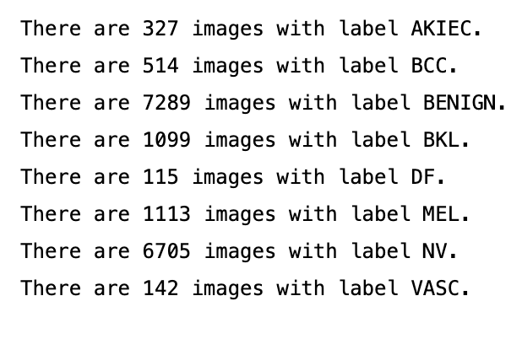
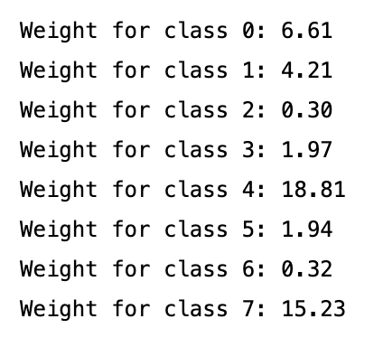
HANDLING CLASS IMBALANCE
Addressing class imbalance is identified as a critical next step in the methodology.
Class imbalance refers to the scenario where some lesion types are underrepresented in the dataset, risking a model bias towards more frequent classes.
To mitigate this issue, class weights are calculated to adjust the model’s focus, ensuring it pays more attention to the less-represented classes.

Slide 8
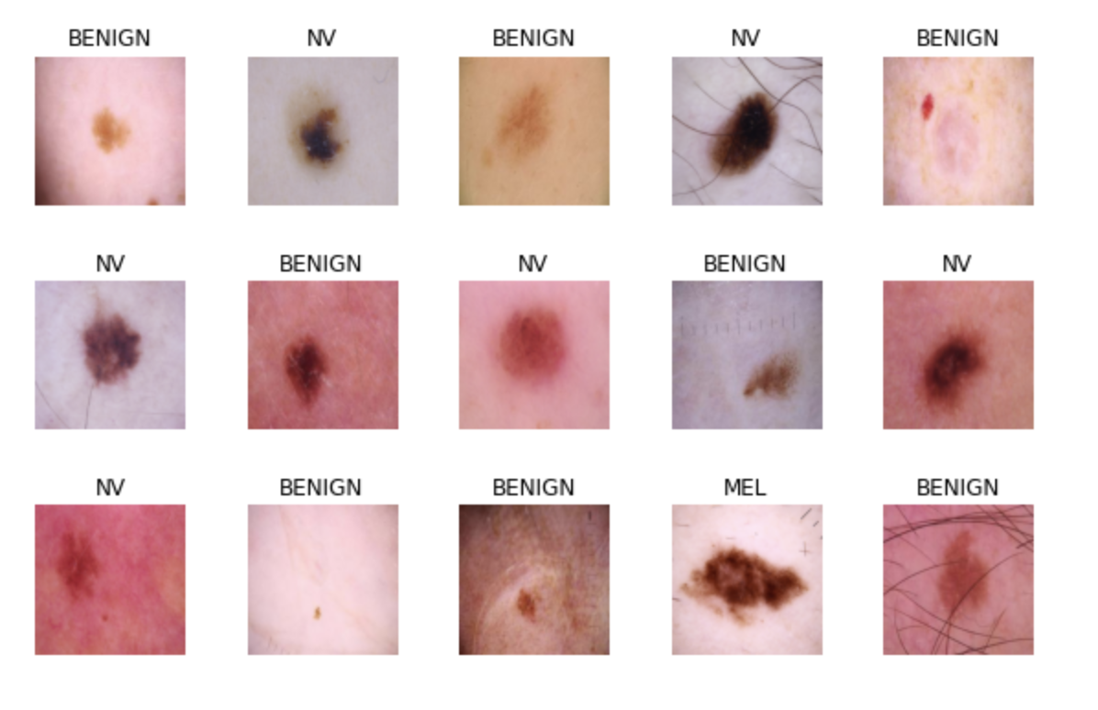
IMAGE RESIZING
Given the model architecture (ResNet50) necessitates a uniform input size, all images are resized to a consistent resolution of 224x224 pixels. This uniformity is critical for efficient model training and optimal performance.
The process involves significant use of PIL to ensure the resized images maintain their quality and relevance for training, aiding in the development of a more accurate and robust model.

Slide 9
TRAINING SPLIT
We use an 80/10/10 split for training
DataLoaders for training, validation, and testing were created with a batch size of 32.
Training DataLoader shuffles images to prevent the model from learning the order of the data.
The number of workers was set to 2, optimizing the loading process based on system capabilities and dataset characteristics

Slide 10
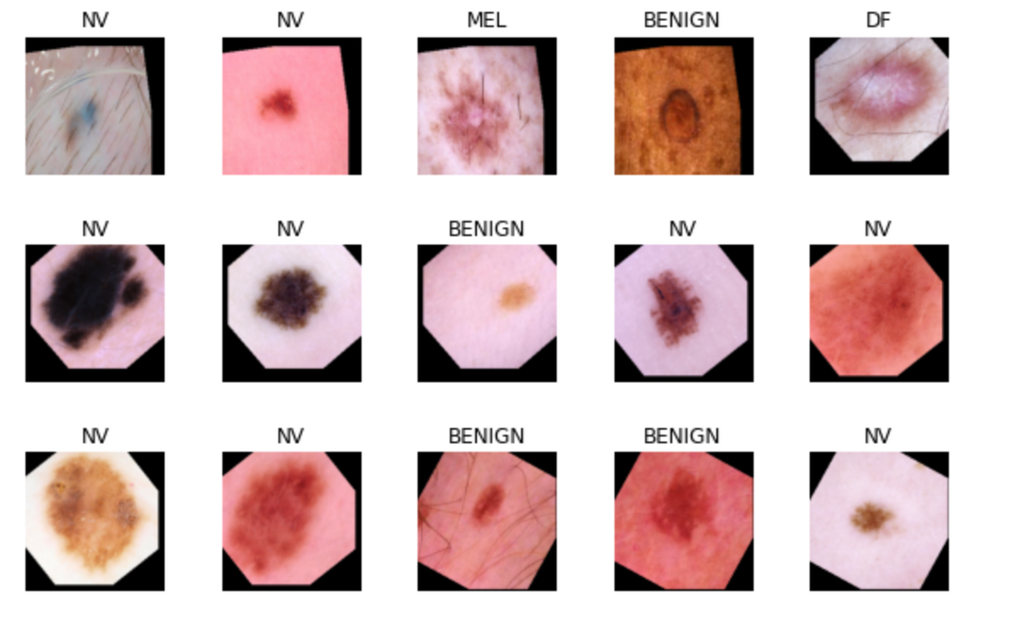
IMAGE AUGUMENTATION USING MULTIPROCESSING
This process is essential for visually inspecting the augmented images and understanding the variety of transformations applied. By increasing the dataset's diversity, the model is better equipped to handle real-world variations in new, unseen images.
The multiprocessing Pool is used to augment images in parallel, improving processing efficiency. The number of processes is set based on the system's capabilities to optimize performance.

Slide 11
RESNET 50 MODEL
We used a custom neural network based on the ResNet50 architecture, fine-tuned for classification tasks with a specific number of output classes.
Modified the ResNet50 model by keeping all layers except the original fully connected layer, allowing for feature extraction while customizing the final classification layer.

Slide 12
INTRODUCING CALLBACKS
Introduced training callbacks for enhanced model training control and efficiency.
Implemented model checkpointing to save the model at specific intervals or performance milestones.
Implemented a mechanism to halt training early and reduce learning rate if validation loss stops improving, enhancing training efficiency and preventing overfitting.

Slide 13
TRAINING
USING MODEL PARALLEL TO TRAIN
Utilized model parallelism technique to distribute the neural network's layers across multiple GPUs, enhancing computational efficiency.
Facilitated the training of more complex models that exceed the memory capacity of a single GPU by distributing model components.
Achieved parallel processing of different model segments, significantly reducing training time and improving model performance.
Training time: 771.23 seconds

Slide 14
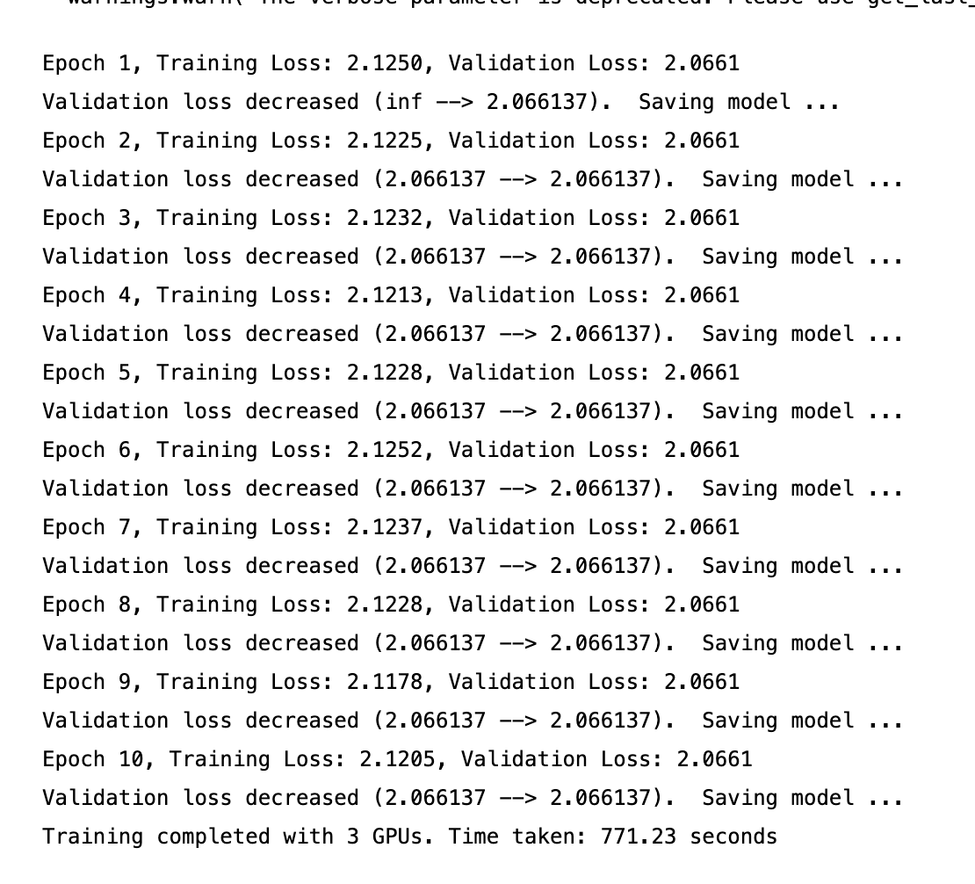
TRAINING
USING MODEL PARALLEL TO TRAIN

Slide 15
TRAINING
USING DATAPARALLEL TO TRAIN
Employed data parallelism to distribute data batches across multiple GPUs, significantly increasing training efficiency.
Optimized the use of available GPUs by dividing the workload evenly, ensuring all resources contribute to the training process.
Made it possible to train models on significantly larger datasets that could not be handled by a single GPU, overcoming memory limitations.
Training time: 484.45 seconds.

Slide 16
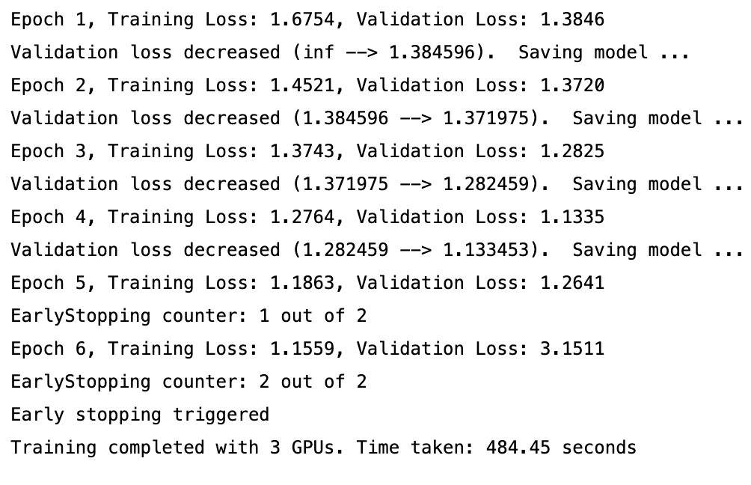
TRAINING
USING DATAPARALLEL TO TRAIN

Slide 17
FINAL RESULT AND CONCLUSION
Model Parallelism: This approach involves splitting the model across multiple GPUs, with each GPU handling a portion of the model's layers. The training time observed using model parallelism was 771.23 seconds
Data Parallelism: In contrast, data parallelism involves distributing the data across multiple GPUs, with each GPU processing a different subset of the data using a complete replica of the model. The training time recorded for data parallelism was 484.45 seconds.

Slide 18
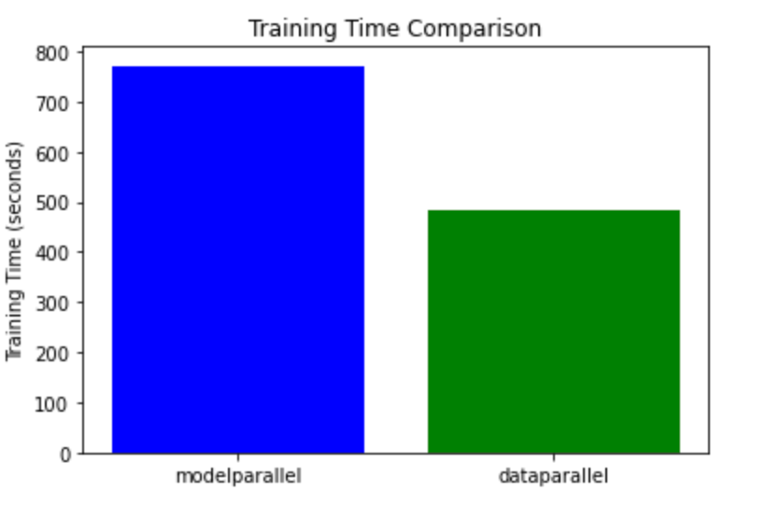
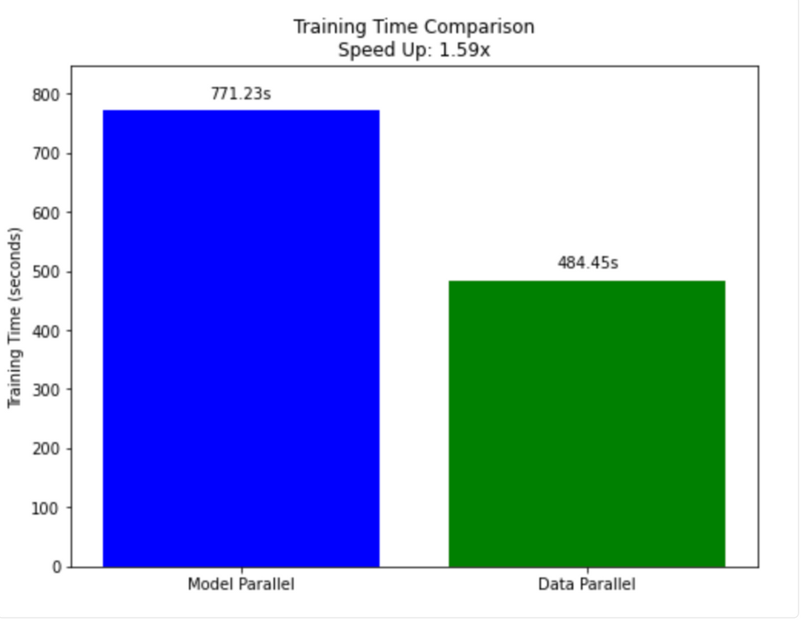
TRAINING TIME AND SPEEDUP

Slide 19
REFERENCES
https://www.kaggle.com/code/quackaddict7/legions-of-lesions-detecting-skin-cancer-with-cv/notebook
https://pytorch.org/docs/stable/index.html
https://stackoverflow.com/questions/51858067/parsing-csv-into-pytorch-tensors

Slide 20
Thank
you!

